Slide 1

Next Hike Solutions
PROJECT - 2
Data Filtering, Merging and Visualization
- : Presentor :-Preyanshi Pancholi

Slide 2
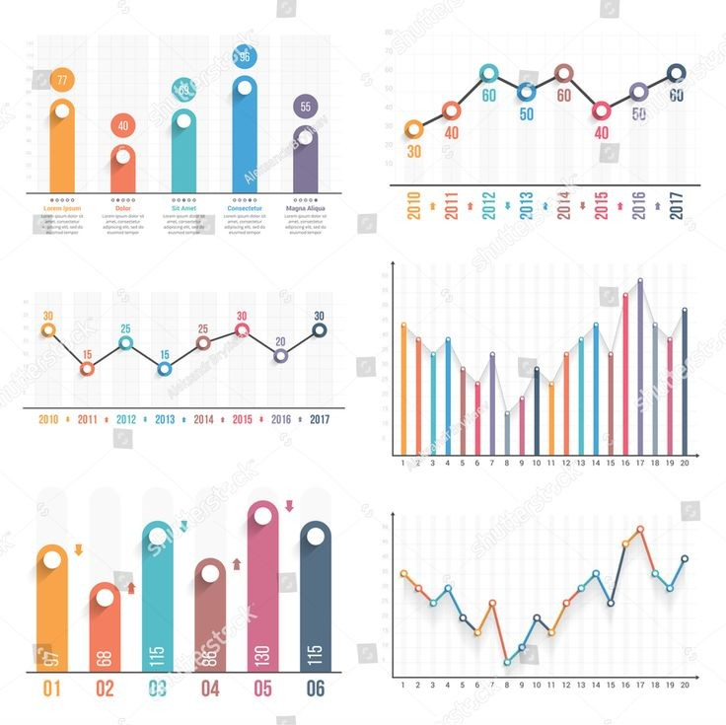
Project Vision, Functionalities & Uniqueness
Data Filtering , Merging and Visualization for better understanding
01.
Visualize the data so any one can have an insights regarding that
02.
Use of different libraries
Create different plot like LinePlot, BarPlot, HistogramPlot and HeatMap
03.

Slide 3
Libraries and their Fucntionality
Pandas :
For importing Data, Data Cleaning, Data Merging, Data Classification and Data Exporting
Scipy.Stats :
For Calculation of Skewness & Kurtosis
Numpy :
For Numeric Calculation like IQR, Percentile and Searching the Outliers
Matplotlib.Pyplot :
For Ploting the Graph, Applying the different methods to the Plot and make Visualization more designing
Seaborn :
For Ploting the different Plot like Bar Plot, Line Plot, Histogram and HeatMap

Slide 4
Challenges & Solutions
Challenges :-
Solutions :-
🔍 1. Data Filtering
Missing or NaN values affect filtering logic
Complex filtering conditions are hard to write and debug
Case sensitivity causes string mismatches
🔗 2. Data Merging
Mismatched or non-unique keys result in incorrect merges
Performance issues with large datasets
Column name conflicts (e.g., _x, _y suffixes after merge)
📈 3. Data Visualization
Overplotting makes graphs unreadable with large datasets
Misleading axis scales distort data representation
Missing labels, legends, or poor formatting affect clarity
🔍 1. Data Filtering
Use .dropna() or .fillna() to handle missing values
Use clear logical operators (&, |) with parentheses
Normalize strings with .str.lower() and .str.strip()
🔗 2. Data Merging
Ensure consistent key types with .astype(str)
Optimize memory with .astype('category') or use Dask for large data
Resolve name conflicts with suffixes=('_left', '_right') in merge()
📈 3. Data Visualization
Sample or aggregate data (df.sample()) to reduce overplotting
Apply log scales (plt.yscale('log')) or set axis limits
Add clear titles, labels, and rotate ticks for readability

Slide 5
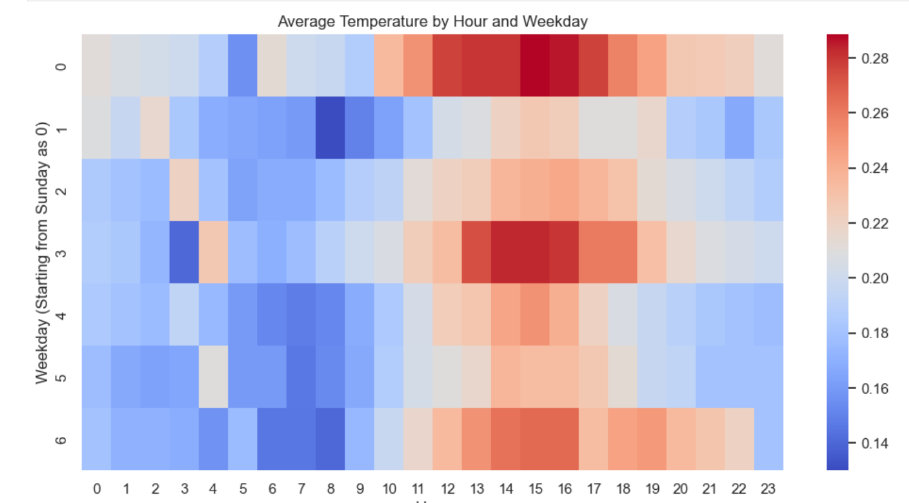
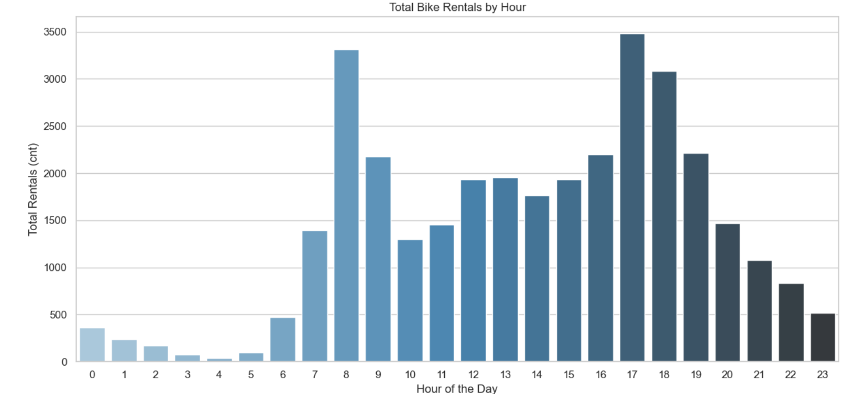
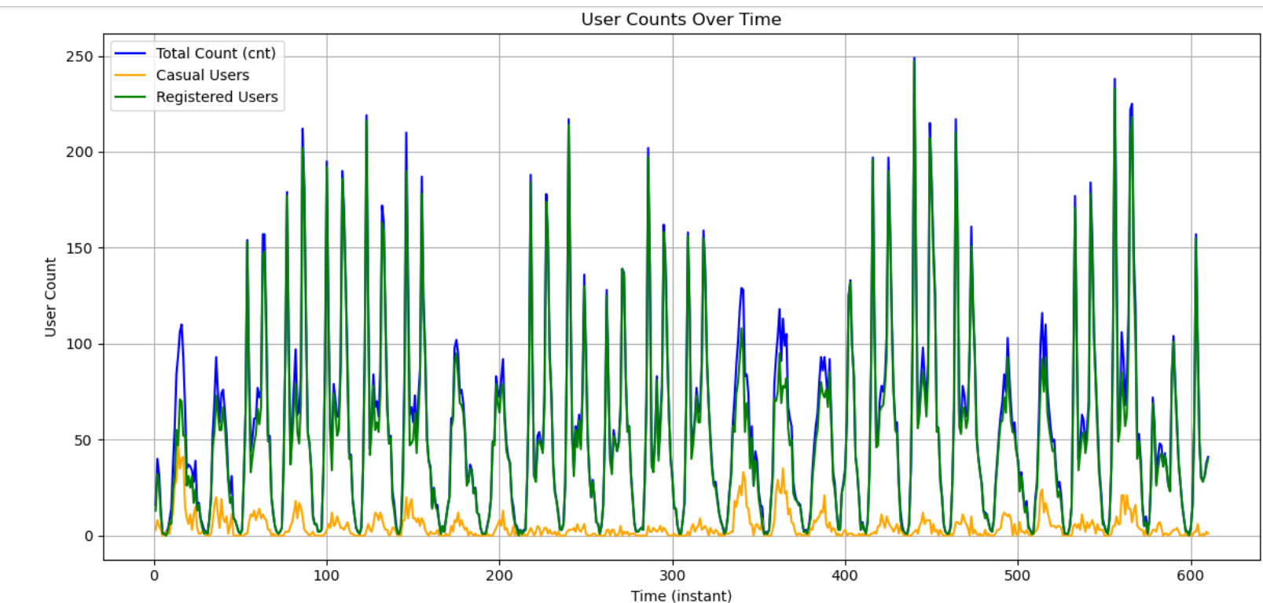
DATA VISUALIZATION

Slide 6
THANK YOU
Data Visualization Presentation

